Slide 1
Bios 520-Clinical Trials-Phases-
Feb 16, 2023

Slide 2
Outline
Syllabus update/timeline
Reading in canvas
Lecture: Randomization

Slide 3
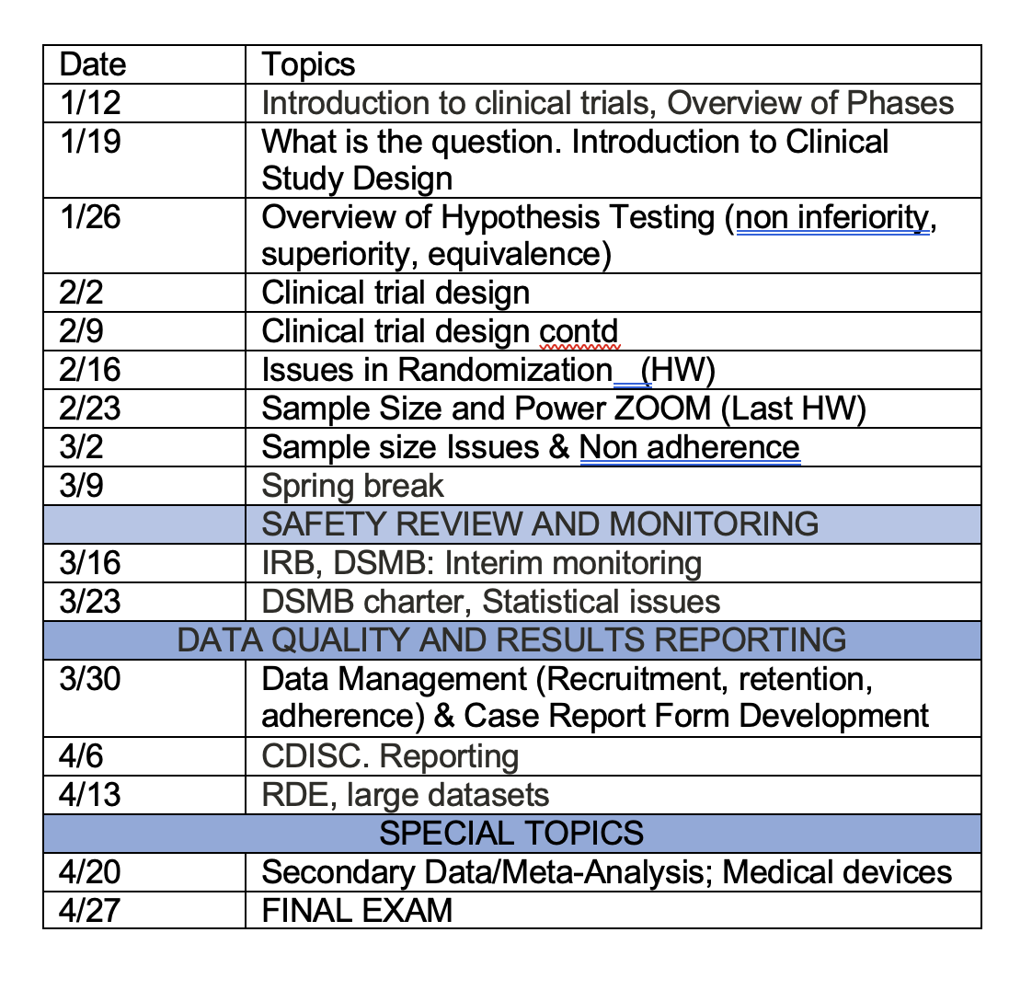
Syllabus update

Slide 4
Masking or blinding (1)
Keeping the identity of treatment assignments masked for
Subject
Investigator, treatment team or evaluator
Evaluation teams
Purpose of masking: bias reduction
Each group masked eliminates a different source of bias
Masking is most useful when there is a subjective component to treatment or evaluation (next slide)

Slide 5
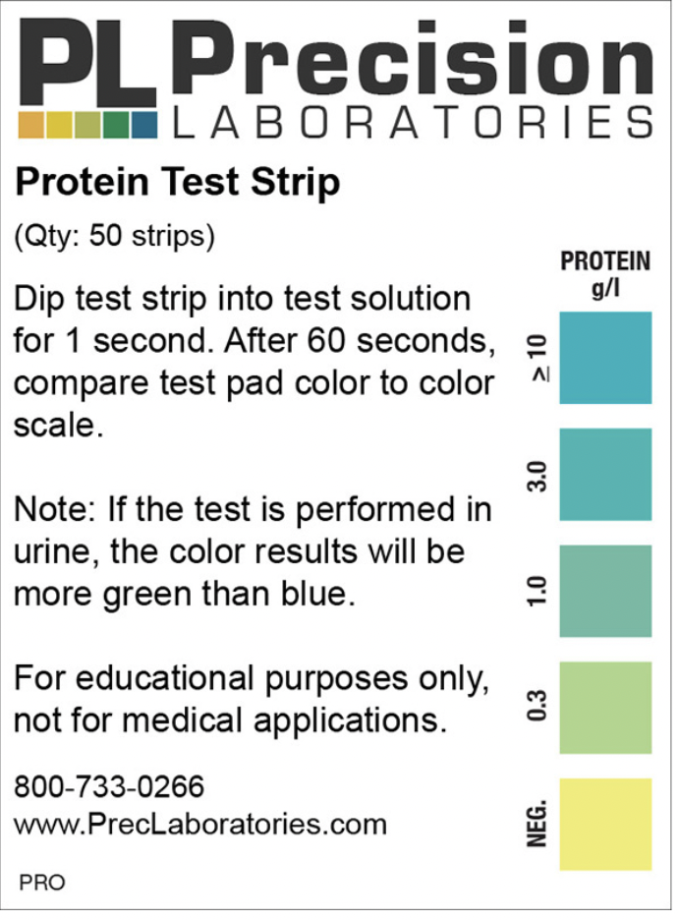
Subjective evaluation
Patient perspective
Pain
Quality of life
Symptoms
Provider perspective
Tumor size
Protein

Slide 6
Blinding or Masking (2)
No Blind
All patients know treatment
Single Blind
Patient does not know treatment
Double Blind
Neither patient nor health care provider know treatment
Triple Blind
Patient, physician and statistician/monitors do not know treatment
Double blind recommended when possible

Slide 7
Blinding or Masking (3)
Assures that subjects are similar with regard to post-treatment variables that could affect outcomes
Minimizes the potential biases resulting from differences in management, treatment, or assessment of patients, or interpretation of results
Avoids subjective assessment and decisions by knowing treatment assignment

Slide 8
Feasibility of Masking
Ethics: The double-masking procedure should not result in any harm or undue risk to a patient
Practicality: It may be impossible to mask some treatments
Avoidance of bias: Masked studies require extra effort (manufacturing look-alike pills, setting up coding systems, etc)
Compromise: Sometimes partial masking, e.g. independent masked evaluators, can be sufficient to reduce bias in treatment comparison
Although masked trials require extra effort, sometimes they are the only way to obtain an objective answer to a clinical question

Slide 9
Reasons for Subject Masking
Those on ‘no treatment’ or standard treatment may be discouraged or drop out of the study
Those on the new drug may exhibit a ‘placebo’ effect (ie the new drug may appear better when it is actually not
Subject reporting and cooperation may be biased depending on how the subject feels about the treatment

Slide 10
Unbiased Evaluation
Subject Bias (NIH Cold Study)
(Karlowski, 1975)
Duration of Cold (Days)
Blinded Unblinded
Subjects Subjects
Placebo 6.3 8.6
Ascorbic Acid 6.5 4.8

Slide 11
Reasons for Treatment team masking
Treatment decisions can be biased by knowledge of the treatment, especially if the treatment team has preconceived ideas about either treatment
Dose modifications
Intensity of patient examination
Need for additional treatment
Influence on patient attitude through enthusiasm (or not) shown regarding the treatment

Slide 12
Unbiased Evaluation
Investigator Bias - (Taste & Smell Study)
(Henkin et al, 1972 & 1976)
Single Blind Double Blind
Zinc 8/8* 5/8
Placebo 0/8 7/8
*Number of variables with significant improvement/Number of variables

Slide 13
Reasons for Evaluator (Third Party) Masking
If endpoint is subjective, evaluator bias will lead to recording more favorable responses on the preferred treatment
Even supposedly “hard” endpoints often require clinical judgment, e.g., blood pressure, MI

Slide 14
Reasons for Monitoring Committee Masking
Treatments can be objectively evaluated
Recommendations to stop the trial for ‘ethical’ reasons will not be based on personal biases
Sometimes, however, triple-mask studies are hard to justify for reasons of safety and ethics
A policy not recommended, not required by FDA

Slide 15
Randomized Consent Design Zelen (NEJM, 1979)
Group I: Regular Care
(TRT A)
Patient Randomize
Group II:
Experimental Consent
(TRT B)
NO
(TRT A)
YES
(TRT B)

Slide 16
Randomized Consent (Zelen, 1979 NEJM)
Usual Order Proposed Order
Screen Screen
Consent Randomize
Randomize Consent
(from Exp. Group only)
Advantages
Easier Recruitment
Disadvantages
Need Low Refusal Rate
Control Must Be Standard
Unblinded
Ethical? POLL
Refusal Rate→ Dilution → Increase Sample Size
15% → 2x

Slide 17
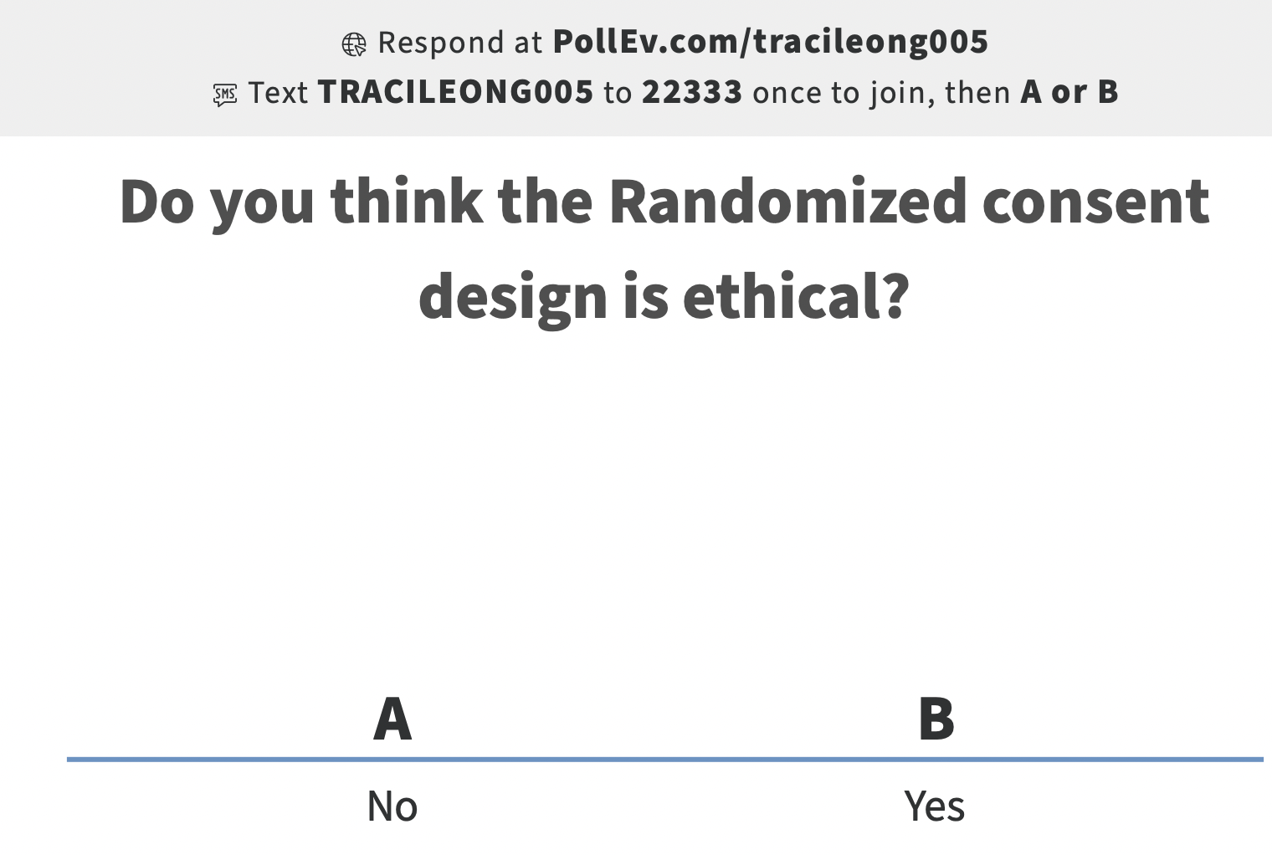
Poll!

Slide 18
Randomization topics to cover
Why randomize
What a random series is
How to randomize

Slide 19
Why Randomize
Randomization, in the simplest case, is a process by which all participants are equally likely to be assigned to either the intervention or control group. There are three advantages of the randomized design:
Bias is minimized
Tends to produce comparable groups
Produces valid statistical tests
In summary, randomization permits a more definitive interpretation of the trial results.

Slide 20
Bias
In any clinical trial, bias is one of the main concerns. Bias may be defined as systematic error, or difference between the true value and that actually obtained due to all causes other than sampling variability.
Selection bias occurs if the allocation process is predictable. The decision to enter a participant into a trial is influenced by the anticipated treatment assignment. It can be caused by conscious factors, subconscious factors, or both.
Accidental bias arises if the randomization procedure does not achieve balance on risk factors or prognostic covariates.

Slide 21
Accidental bias
Are large or small studies more vulnerable to accidental bias?
Why?

Slide 22
Random series
How can we apply this to a clinical trial?

Slide 23
Now..how to randomize?

Slide 24
Fixed allocation
Fixed number of patients going to intervention and control arms
Usually 1:1 ratio
Types of fixed allocation
Simple
Block
Stratified

Slide 25
Advantages of a 2:1 ratio
Less information may be needed about the control group.
Researchers gain more information about participant responses to the new intervention (e.g., toxicity and side effects).
If the intervention turns out to be beneficial, more study subjects would benefit.
Recruitment may be easier.
The cost of standard care may be more expensive.

Slide 26
Disadvantages of unequal allocation
Sensitivity/power is reduced.
The intervention may turn out to be harmful.
The cost of the intervention may be more expensive.
The participants and the physicians will get the impression that one intervention is preferred over the other.

Slide 27
Allocation procedures to Achieve Balance
Simple randomization
Permuted block randomization
Balanced permuted block randomization
Stratified randomization
Biased coin randomization

Slide 28
Simple randomization
When assigning a subject to one of two groups (A or B), the investigator may
toss an unbiased coin
refer to a random digits table
use a random number-generating algorithm, available on most computers
A sequence of assignments that is random in order is generated, and each participant has an equal chance of being assigned to group A or B.

Slide 29
Goal: Achieve Comparable Groups to Allow Unbiased Estimate of Treatment
Beta-Blocker Heart Attack Trial
Baseline Comparisons
Propranolol Placebo
(N-1,916) (N-1,921)
Average Age (yrs) 55.2 55.5
Male (%) 83.8 85.2
White (%) 89.3 88.4
Systolic BP 112.3 111.7
Diastolic BP 72.6 72.3
Heart rate 76.2 75.7
Cholesterol 212.7 213.6
Current smoker (%) 57.3 56.8

Slide 30
Assignment based on coin flip
Before we can discuss comparability of groups, NUMBER of patients in each randomized treatment may not be the same
An unbiased coin can yield an arbitrarily long sequence of heads purely by chance. Just as importantly, excess heads (or tails) would be the rule at all except a very few points in a long series of random coin tosses.
http://www.shodor.org/interactivate/activities/Coin/
What does this tell you about differing ‘N’?
What does this tell you about accidental bias and size of study with simple randomization?

Slide 31
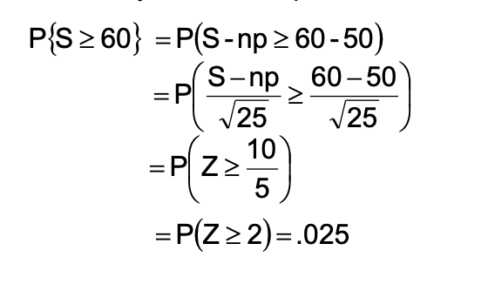
Randomization & Balance (1) Coin Flip
N=100 tosses of a coin
P=1/2 for a fair coin
S=# heads
E(S)= n* p=50
V(S)= n*p*q= 100*1/2*1/2=25
Probability of a 60:40 split

Slide 32
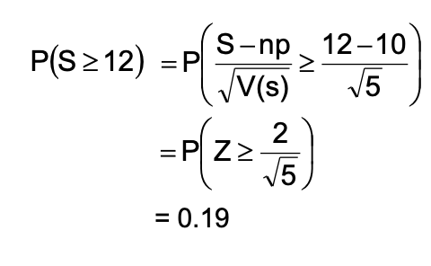
Randomization & Balance (2)
N=20
P=1/2
E(S)= n* p=10
V(S)= n*p*q= 5
Probability of a 12:8 split or worse

Slide 33
How to perform a simple randomization
The code below generates 100 single-digit random numbers.
data rdt; seed = 374947; do i = 1 to 100;
randno = int(ranuni(seed)*10);
output; end;
drop seed i; run; proc print data=rdt; run;
proc freq data=rdt; tables randno; run;

Slide 34
Now what to do with the random numbers?
8971642190666299003251373941094773 8191241218694173251484520679157228 2460613655447665818866671483605128 3009975050396101593607090919706447 5251796463999283466342490027170887 9849380004535070536663072134680899 8937815997406184824378063061806617 3521467597903907540103895373518618 0750063764974943294179210689431247 0496055772774833763040594388840956 9346979613188634826680521859602866 2302624357359146678898941868841792 7774217659041015401558110952774676 0834985009280694346014246088715781 0002640489258965832715731444534021 7513473546702192561557197398615995

Slide 35
Nature of Random Numbers and Randomness
A completely random sequence of digits is a mathematical idealization
Each digit occurs equally frequently in the whole sequence
Adjacent (set of) digits are completely independent of one another
Moderately long sections of the whole show substantial regularity
A table of random digits
Produced by a process which will give results closely approximating
to the mathematical idealization
Tested to check that it behaves as a finite section from a
completely random series should
Randomness is a property of the table as a whole
Different numbers in the table are independent

Slide 36
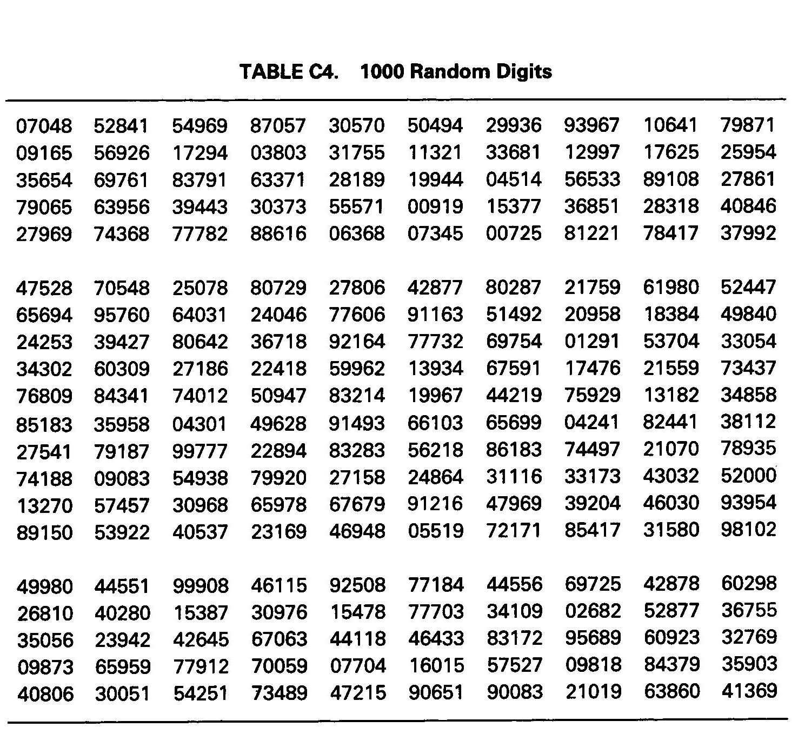
Table of Random Numbers

Slide 37
For a smaller type of study
Randomly select row or column
Odd=Treatment A
Even=Treatment B

Slide 38
What about a large study?
Use a random number producing algorithm
Assign participants treatment A probability p
Assign participants treatment B to probability 1-p
Use ranuni as in previous slide (SAS)
Use runif (R )
Suppose a trial has three groups: A, B and C. Equal allocation is desired. How could simple randomization be implemented?

Slide 39
Imbalances resulting from simple randomization
While such imbalances do not make the statistical tests invalid, they do reduce ability to detect true differences between the two groups.
Such imbalances may lead to some loss of credibility for the clinical trial.
Simple randomization is not often used, even for large studies. It is desirable to restrict randomization to ensure balance throughout the trial.
Question. How can randomization be restricted?

Slide 40
Simple randomization
Advantage. It is simple and easy to implement.
Disadvantage. Patient characteristics can change during recruitment. For example, patients recruited early could be sicker than those recruited later. In this situation, the early imbalances created by simple randomization cannot be corrected.

Slide 41
Simple Randomization Disadvantages contd
At any point in time, there may be an imbalance in the number of subjects on each treatment
With n = 20 on two treatments A and B, the chance
of a 12:8 split or worse is approximately 0.19
With n = 100, the chance of a 60:40 split or worse is approximately 0.025
Balance improves as the sample size n increases
Thus desirable to restrict randomization to ensure balance throughout the trial

Slide 42
A-B-A-B-A-B ?
Question. A co-investigator tells you that he will be using an alternating assignment of participants to groups A and B (i.e., ABABAB. . .). He believes this is a form of randomization. How will you respond?
Answer. No random component exists in this type of allocation except perhaps for the first participant. In a single or unblinded study, the investigators know the next assignment, which could lead to a bias in the selection of participants. Even in a double blind-study, if the blind is broken on one participant (as it sometimes happens), the entire sequence of assignments is known. This type of allocation method should be avoided.

Slide 43
Restricted Randomization
Simple randomization does not guarantee balance over time in each realization
Patient characteristics can change during recruitment (e.g. early pts sicker than later)
Restricted randomizations guarantee balance
1. Permuted-block
2. Biased coin
3. Urn design (not discussed)

Slide 44
Permuted-Block Randomization
Simple randomization does not guarantee balance in numbers during trial
If patient characteristics change with time, early imbalances
can't be corrected
Need to avoid runs in Trt assignment
Permuted Block insures balance over time
Basic Idea
Divide potential patients into B groups or blocks of size 2m
Randomize each block such that m patients are allocated to A and m to B
Total sample size of 2m B
For each block, there are _{2m}C_{m} possible realizations
(assuming 2 treatments, A & B)
Maximum imbalance at any time = 2m/2 = m

Slide 45
Permuted-Block Randomization
Method 1: Example
Block size 2m=4 (after every 4th randomized subject, the number of participants in each intervention group are equal.)
2 Treatments A, B -→ ₄C₂= 6 possible
Write down all possible assignments
For each block, randomly choose one of the six possible arrangements
{AABB,ABAB,BAAB,BABA,BBAA,ABBA}
ABAB BABA …
Patients:
1 2 3 4 5 6 7 8. 9 10 11 12

Slide 46
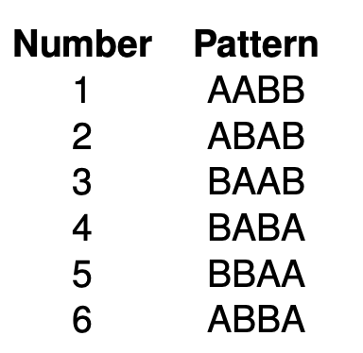
Can we use our random number table with permuted blocks?
The first few digits in the SAS-generated random digits table are: 89716421....
We ignore 8, 9 and 7 because they don’t have a corresponding pattern in the table above. But we use 1, 6, 4, 2, 1. So the sequence is
AABB—ABBA—BABA—ABAB—AABB...

Slide 47
Summary
It guarantees that at no time during randomization will the imbalance in the number of participants assigned to each group be large and that at certain points the number of participants in each group will be equal.
The order in which the interventions are assigned in each block is randomized, and the process is repeated for consecutive blocks of subjects until all subjects are randomized.

Slide 48
Permuted block advantage
If b is the size of each block, the number of participants in each group will never differ by more than b/2.
Question. Why is this important?
the type of subject recruited for the study may change during the entry period
the trial may be terminated before enrollment is completed

Slide 49
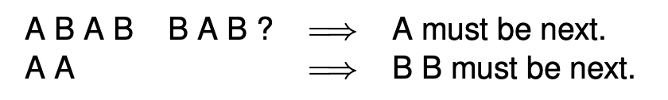
Permuted block disadvantage
If blocking is not masked, the sequence becomes somewhat predictable.
This could lead to bias in the selection of every fourth participant to be entered.
Simple Solution to Selection Bias
Do not reveal blocking mechanism
Use random block sizes
If treatment is double blind, no selection bias

Slide 50
Random block size
Suppose the size of the blocks can be set at 2, 4, 6 and 8.
Assign a probability of selecting each block size; the probabilities have to add up to 1. For example, the probabilities of selecting block sizes 2, 4, 6 and 8 can be 1/6, 1/6, 1/3, and 1/3 respectively.
After each block has been completed, the size of the next block is determined randomly.

Slide 51
Imbalance in prognostic factors
One of the objectives in allocating participants is to achieve between-group comparability of certain characteristics known as prognostic or risk factors. Measured at baseline, these are factors that correlate with subsequent subject response or outcome.
Investigators may be concerned when prognostic factors are not evenly distributed between intervention and control groups.
For large studies, randomization tends to produce groups that are, on the average, similar in their entry characteristics, both known and unknown. Especially for a small study, there is no guarantee that all baseline characteristics will be similar in the two groups.

Slide 52
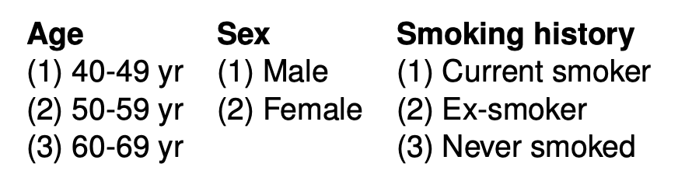
Example
Suppose an investigator wants to stratify on age, sex, and smoking history.
The design has 3 × 2 × 3 = 18 strata.
Subjects who were between 40 and 49 years old, male and current smokers (i.e., subjects in the 1st stratum) would be assigned to groups A or B. Blocked randomization could also be used within each stratum. In this case, subjects who were between 40 and 49 years old, male and current smokers (i.e., subjects in the 1st stratum) would be assigned in sequences ABBA, BABA, and so on (if the block size was decided to be 4). Similarly, random sequences would appear in other strata.

Slide 53
Balancing on Baseline Covariates
Stratified Randomization
Covariate Adaptive
Minimization
Pocock & Simon

Slide 54
Stratified randomization
The prognostic factors are measured either before or at the time of randomization.
The total number of strata is the product of the number of subgroups in each factor.
The stratum to which each subject belongs is then determined, and then randomization is performed within that stratum.
Within each stratum, the randomization process itself could be simple randomization, but in practice most clinical trials use some blocked randomization strategy. When employing blocked randomization, the block size should be relatively small to maintain balance in small strata and to ensure that the overall imbalance is not too great.

Slide 55
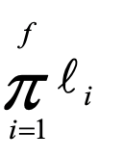
Stratified randomization
May desire to have treatment groups balanced with respect to prognostic or risk factors (covariates)
For large studies, randomization “tends” to give balance
For smaller studies a better guarantee may be needed
Divide each risk factor into discrete categories
Number of strata
f = # risk factors;
l_{i} = number of categories in factor i
Randomize within each stratum
For stratified randomization, randomization must be restricted! Otherwise, (if CRD was used), no balance is guaranteed despite the effort.

Slide 56
Example
Sex (M,F)
and
Risk (H,L)
H
1 2 Factors
2 2 Levels in each
⇒ 4 Strata
3
4
M
L
F
H
L
For stratified randomization, randomization must be restricted!
Otherwise, (if CRD was used), no balance is guaranteed despite the effort!

Slide 57
Stratified Randomization (2)
Define strata
Randomization is performed within each stratum and is usually blocked
Example: Age, < 40, 41-60, >60; Sex, M, F Total number of strata = 3 x 2 = 6 Age Male Female 40 ABBA, BAAB, … BABA, BAAB, ... 41-60 BBAA, ABAB, ... ABAB, BBAA, ... >60 AABB, ABBA, ... BAAB, ABAB, ..

Slide 58
Stratified Randomization (3)
The block size should be relatively small to maintain balance in small strata, and to insure that the overall imbalance is not too great
With several strata, predictability should not be a problem
Increased number of stratification variables or increased number of levels within strata lead to fewer patients per stratum
In small sample size studies, sparse data in many cells defeats the purpose of stratification
Stratification factors should be used in the analysis
Otherwise, the overall test will be conservative

Slide 59
Comment
For multicenter trials, clinic should be a factor
Gives replication of “same” experiment.
Strictly speaking, analysis should take the particular randomization process into account; usually ignored (especially blocking) & thereby losing some sensitivity.
Stratification can be used only to a limited extent, especially for small trials where it's the most useful;
i.e. many empty or partly filled strata.
If stratification is used, restricted randomization within strata must be used.

Slide 60
Blocked vs stratified
Blocked randomization: stratifying over time
Stratified randomization: stratifying on factors other than time

Slide 61
Advantages/disadvantages
Advantages:
With several strata, predictability should not be a problem.
The power of the study can be increased by taking the stratification factors into account in the analysis, as the variability in group comparisons is reduced. Stratified randomization, in a sense, breaks the trial down into smaller trials.
Disadvantage.
Increased number of stratification variables or increased number of levels within strata lead to fewer patients per stratum. In small sample size studies, sparse data in many cells defeat the purpose of stratification (Pocock & Simon, 1975). Thus, only important variables should be chosen, and the number of strata should be kept to a minimum.

Slide 62
Stratifying pre vs post randomization
How to correct for baseline imbalances:
Use stratification in the analysis
Sometimes the variables initially thought to be the most important turn out to be unimportant. Other factors may be identified later that are of more importance. For a large study, stratification after randomization provides efficiency nearly equal to stratification before randomization.
Use stratification in the randomization
For studies of 100 subjects or fewer, stratifying the randomization using two or three prognostic factors may achieve greater power, although the increase may not be large.

Slide 63
Biased coin
Class of randomization procedures designed to eliminate or substantially reduce the problems of simple and permuted block randomization procedures by minimizing the size any treatment imbalance in a trial and reducing the chance of long runs of one treatment group.
As soon as the treatments become sufficiently imbalanced favoring one treatment, then the randomization is chosen to favor the other treatment to balance more quickly while still incorporating randomization so that the physician can never be certain of the next treatment assignment

Slide 64
Biased coin premise
Select some integer D as discrepancy and a probability π<.5
At any point, if the difference between n_{A} and n_{B} is no bigger than D then probability of assignment to A is .5
IF the discrepancy >D then probability of A is π and probability of B is 1- π
Suggested to have 2/3 and 1/3

Slide 65
Response Adaptive Allocation Procedures
Use outcome data obtained during trial to influence allocation of patient to treatment
Data driven (ie dependent on outcome of previous patient)
Assumes patient response known before next patient
Goal is to allocate as few patients as possible to a seemingly inferior treatment
Issues of proper analyses quite complicated
Not widely used though much written about
Controversial

Slide 66
Play the winner rule
1st subject: toss a coin.. Heads=Trt A, Tails=Trt B
Subsequent subjects: assign previous treatment if it was successful
Otherwise switch treatment assignment for next patient
Advantage: Potentially more patients receive the better treatment
Disadvantage: Investigator knows next assignment

Slide 67
Response Adaptive Randomization
Example
TRT A S S F S S S F
TRT B S F
Patient 1 2 3 4 5 6 7 8 9 ......

Slide 68
Two-armed Bandit or Randomized Play-the-Winner Rule
Treatment assignment probabilities depend on observed success probabilities at each time point
Example: ECMO trial
Advantage: Attempts to maximize the number of subjects on the “superior” treatment
Disadvantage: When unequal treatment numbers result, there is loss of statistical power in the treatment comparison

Slide 69
ECMO Example
Michigan paper uploaded in canvas

Slide 70
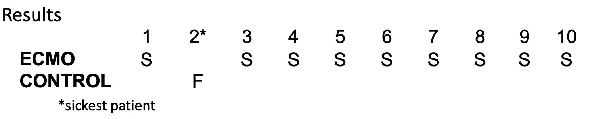
Michigan ECMO Trial
Modified “play-the-winner”
Urn model
A ball → ECMO
B ball → Standard control
If success on A, add another A ball .…
Wei & Durham JASA (1978)
Randomized Consent Design
Results

Slide 71
Multi institutional trials
Often, there is a marked institution effect on outcome measures
Using permuted blocks within strata, adding institution as yet another stratification factor will probably lead to sparse cells (and potentially more cells than patients!)
Use permuted block randomization balanced within institutions

Slide 72
Mechanics of Randomization (1)
Basic Principle - “Analyze What is Randomized”
* Timing
Actual randomization should be delayed until just prior to initiation of therapy
Example
Alprenolol Trial, Ahlmark et al (1976)
393 patients randomized two weeks before therapy
Only 162 patients treated, 69 alprenolol & 93 placebo

Slide 73
Mechanics of Randomization (2)
* Operational
1. Sequenced sealed envelopes (prone to tampering!)
2. Sequenced bottles/packets
3. Phone call to central location
- Live response
- Voice Response System
4. One site PC system
5. Web based
Best plans can easily be messed up in the implementation

Slide 74
Example of Previous Methods (1)
20 subjects, treatment A or B, risk H or L
Subject Risk
1 H Randomize Using
2 L
3 L 1. Simple
4 H
5 L 2. Blocked (Size=4)
6 L
7 L 3. Stratify by risk + use simple
8 L
9 H 4. Stratify by risk + block
10 L
11 H
12 H For each compute
13 H
14 H 1. Percent pts on A
15 L
16 L 2. For each risk group, percent of pts on A
17 H
18 H
19 L
20 H
10 subjects with H
10 subjects with L

Slide 75
Example of Previous Methods (2)
1. Simple 1st Try 2nd Try
(a) 9/20 A's 7/20 A's OVERALL BY
(b) H: 5/10 A's 3/10 A's SUBGROUP
L: 4/10 A's 4/10 A's
2. Blocked (No stratification)
(a) 10 A's & 10 B's
(b) H: 4 A's & 6 B's
L: 6 A's & 4 B's
3. Stratified with simple randomization
(a) 5 A's & 15 B's
(b) H: 1 A & 9 B's
L: 4 A's & 6 B's
4. Stratified with blocking
(a) 10 A's & 10 B's MUST BLOCK TO MAKE
STRATIFICATION PAY
(b) H: 5 A's & 5 B's OFF
L: 5 A's & 5 B's

Slide 76

Unbiased$≠$balance
There is a common serious misconception regarding unbiased treatment assignments for clinical trials.
The misconception is that unbiased assignment must yield covariate balanced groups, or conversely that unbalanced groups signify a lack of comparability.
An extension of this idea is that imbalance invalidates comparisons even when assignments are unbiased. In truth, bias and balance do not necessarily reflect on each other.

Slide 77
Final thoughts
Cannot force balance everywhere someone could look.
Unlimited supply of potential prognostic factors.
The best we can do is balance a few key variables while guaranteeing an unbiased estimate of treatment effect using randomization.
What are the consequences of the inevitable unbalanced covariates? The answer is that we have already planned for such effects in the error probabilities for the trial.
We are entitled to be wrong by chance, and errors due to randomness, including random influential covariate imbalances, are controlled at an acceptable level by design
Random error is random error whether it is inexplicable or mediated by chance imbalances.

